Slide 1
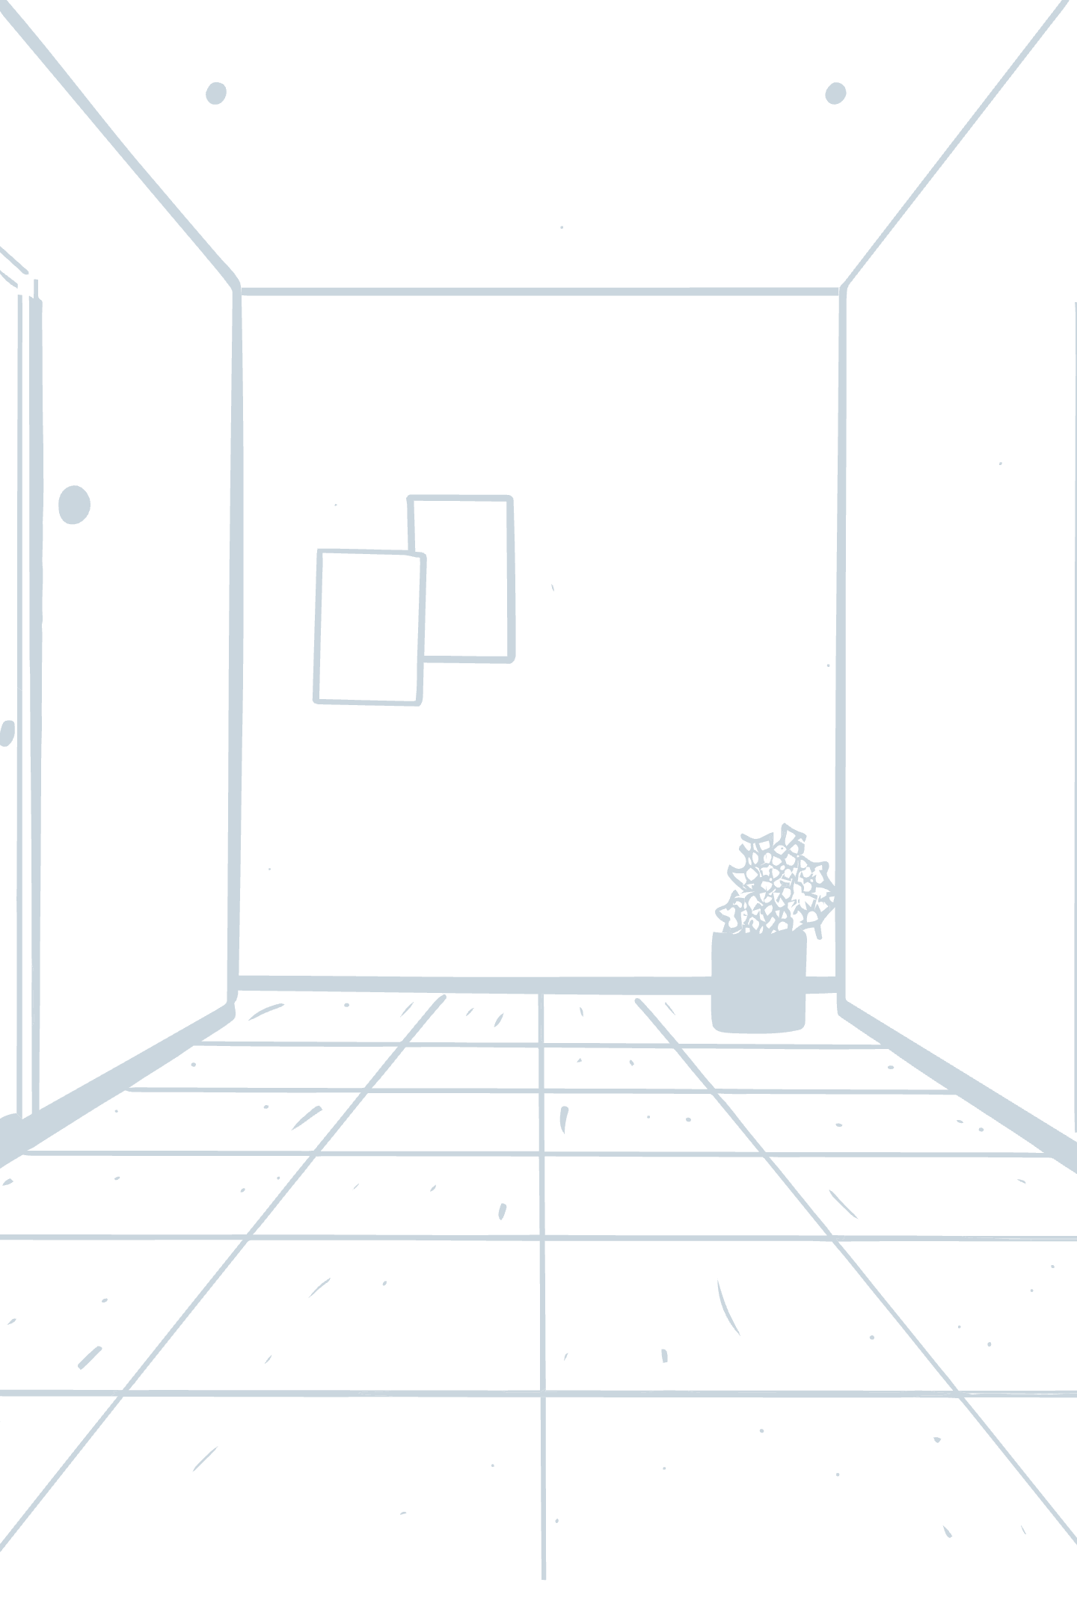
8-Puzzle Problem: Unraveling Search Algorithms
Explore the classic 8-Puzzle, a fundamental problem in Artificial Intelligence, and discover how different search algorithms tackle its complexities.

Slide 2

Our Brilliant Minds Behind the Solution
Youssef Mamdouh
Ahmed Wael
Abdullah Hany
Mastered the Depth First Search (DFS) implementation.
Championed the Breadth First Search (BFS) implementation.
Pioneered the A* Search implementation, achieving optimal results.

Slide 3

What is the 8-Puzzle Problem?
The 8-Puzzle is a classic sliding puzzle game played on a 3x3 grid. It consists of eight numbered tiles and one empty space.
The objective is to rearrange the tiles from a given initial configuration into a specific goal state by repeatedly sliding tiles into the empty space.
Why is it important in AI?
Demonstrates fundamental search algorithms.
Serves as a benchmark for problem-solving strategies.
Illustrates state-space search and heuristic functions.

Slide 4

Defining the Puzzle's Universe
State Space
Initial State
Goal State
Encompasses all possible arrangements of the tiles, forming a vast graph that search algorithms must navigate.
The starting configuration of the puzzle, the point from which the search begins.
The desired configuration where the tiles are arranged in a specific, often ordered, sequence with the empty space in a designated spot.

Slide 5

Depth First Search (DFS)
DFS explores as deeply as possible along each branch before backtracking. It's like exploring a maze by always going forward until you hit a dead end, then returning to the last choice point.
How it applies to 8-Puzzle:
DFS delves into puzzle states, exploring one path completely before considering alternatives. It's suitable when the solution might be found deep in the search tree.
Advantages
Disadvantages
Low memory usage.
May get stuck in very deep paths, leading to infinite loops.
Simple to implement.
Not guaranteed to find the shortest or optimal solution.

Slide 6
Breadth First Search (BFS)
BFS explores all nodes at the current depth level before moving to the next deeper level. Imagine expanding outwards from the starting point in concentric circles.
How it applies to 8-Puzzle:
BFS systematically explores puzzle states layer by layer, guaranteeing that it finds the shortest path to the goal if one exists.
Advantages
Disadvantages
Guarantees the shortest solution path if a solution exists.
High memory usage for large state spaces, as it stores all nodes at each level.
Systematic and complete.
Can be significantly slower for very large search trees.

Slide 7
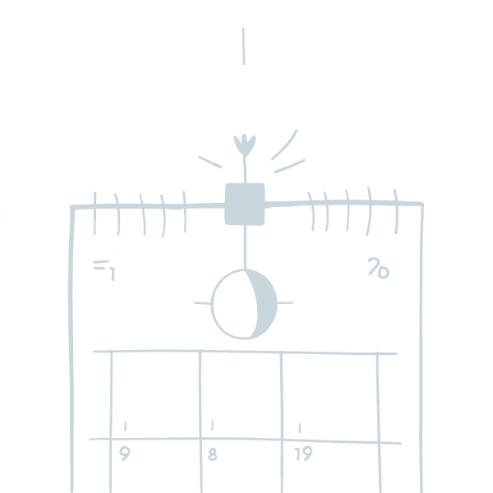
A* Search Algorithm
A* combines the benefits of both BFS and DFS by using a heuristic function to guide its exploration. It prioritizes paths that seem most promising, leading to more efficient searches.
Heuristic Function:
Commonly uses the Manhattan distance heuristic, which calculates the sum of the horizontal and vertical distances of each tile from its correct position in the goal state.
Advantages
Disadvantages
Guarantees optimal solutions with an admissible heuristic.
Requires careful design of a good heuristic function.
More efficient than BFS and DFS for complex problems.
Can still be memory-intensive for extremely large state spaces.

Slide 8
Algorithm Comparison: DFS, BFS, and A*
Algorithm
Time Complexity
Space Complexity
Optimality
Performance
DFS
O(b^d)
O(d)
Not Optimal
Fast but Incomplete
BFS
O(b^d)
O(b^d)
Optimal
Slow, Memory-Heavy
A*
O(b^d) (Guided)
Depends on Heuristic
Optimal (with good heuristic)
Efficient and Effective
b: branching factor, d: depth of the solution.

Slide 9



Why A* Reigns Supreme for 8-Puzzle
1
Efficiency
2
Optimality
3
Performance
A* stands out by intelligently reducing the search space and guaranteeing the shortest solution when using an admissible heuristic. It skillfully balances exploration and exploitation, making it the most practical and powerful algorithm for solving the 8-Puzzle Problem.

Slide 10

Thank You!
We appreciate your attention and hope this presentation has shed light on the fascinating world of search algorithms and the 8-Puzzle Problem.
Questions? Reach out to our team for more insights into DFS, BFS, and A*!

